Slide 1
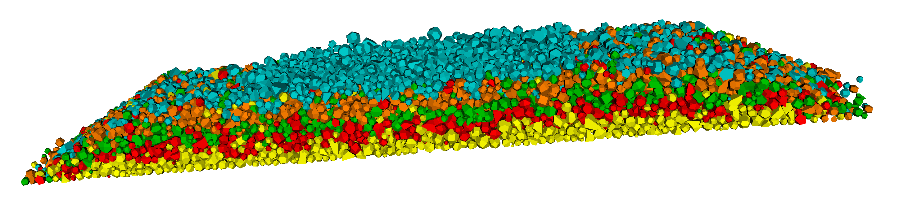
Data-driven ballast layer evaluation and prediction based on machine learning models
Bin Feng

Slide 2
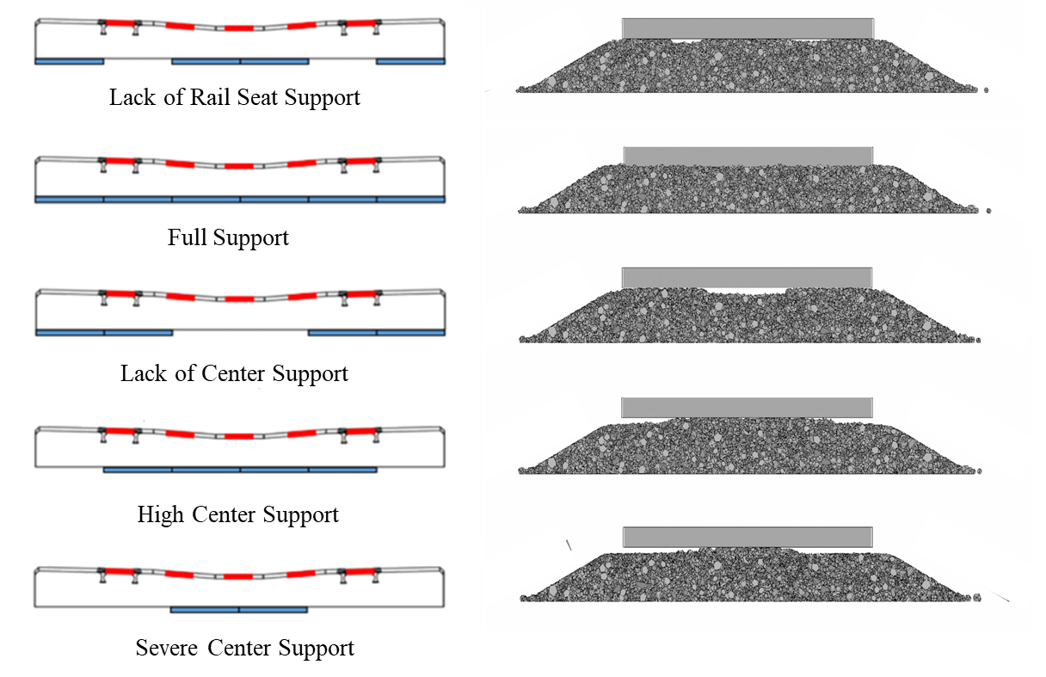
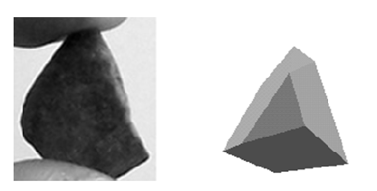
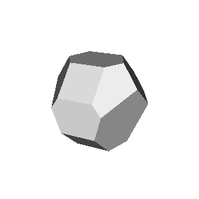

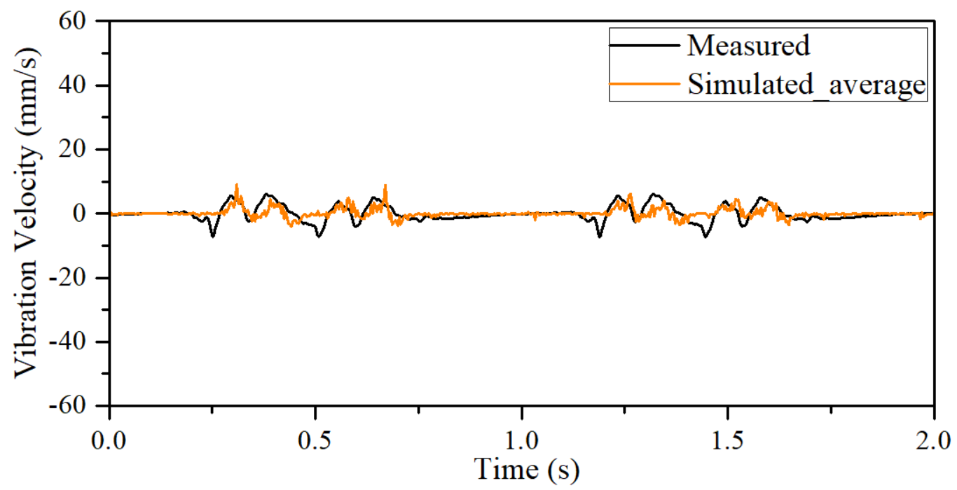
INTRODUCTION
Ballast Layer
Ballast Particle
GBs of data:
location
movement
velocity
force
…

Slide 3
OBJECTIVE (I)
TOP BALLAST
Empirical
SHLDR.
BOTTOM BALLAST
SHLDR.
Data-driven
Un/Semi-supervised Learning
Hierarchical clustering
K-means/K-medoids clustering
Mixture model based clustering
…

Slide 4
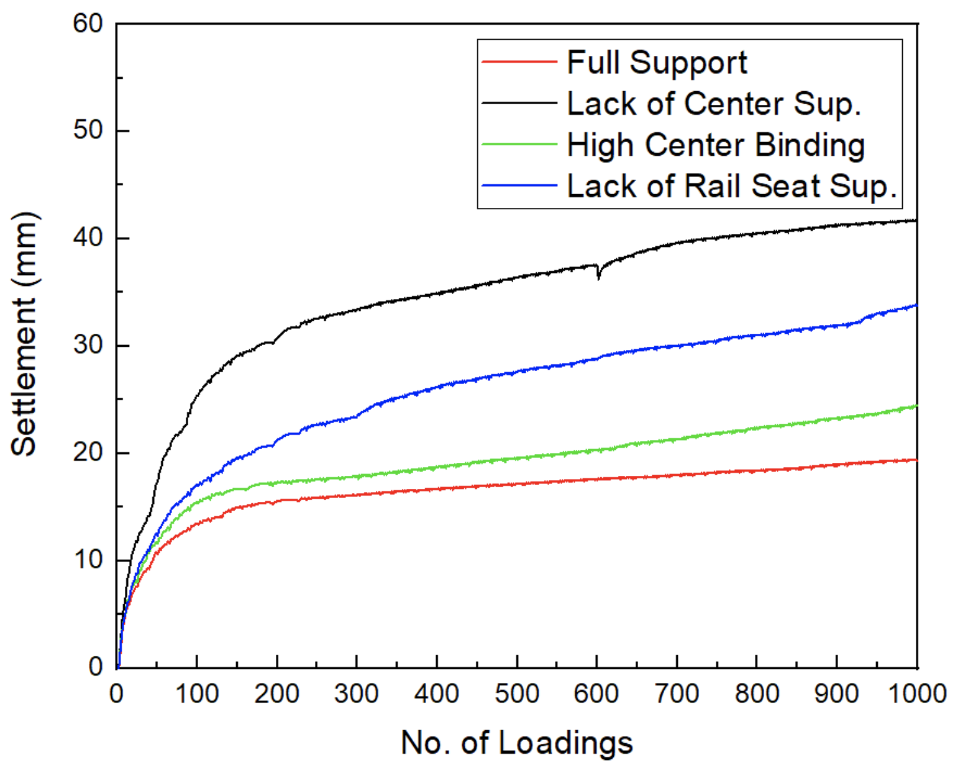
OBJECTIVE (II)
Clustering Model
Prediction Model
ARMA
LSTM
…

Slide 5
OBJECTIVE (III)
Clustering Model
Classification Model
?
SVM
Logistic
Classification Tree
…

Slide 6
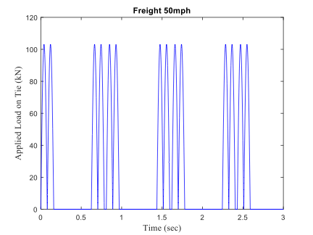
MODEL SETUP
DEM Model
Loading Pattern
Lack of Rail Seat Support
Freight 50mph
110 mph
150 mph
Full Support
20 mph
50 mph
Lack of Center Support
16 cases (3 weeks)
8 train cars/case
High Center Binding

Slide 7
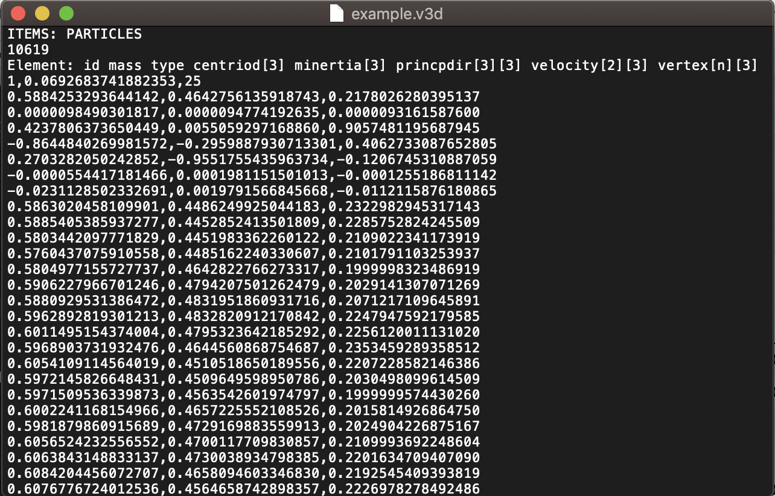
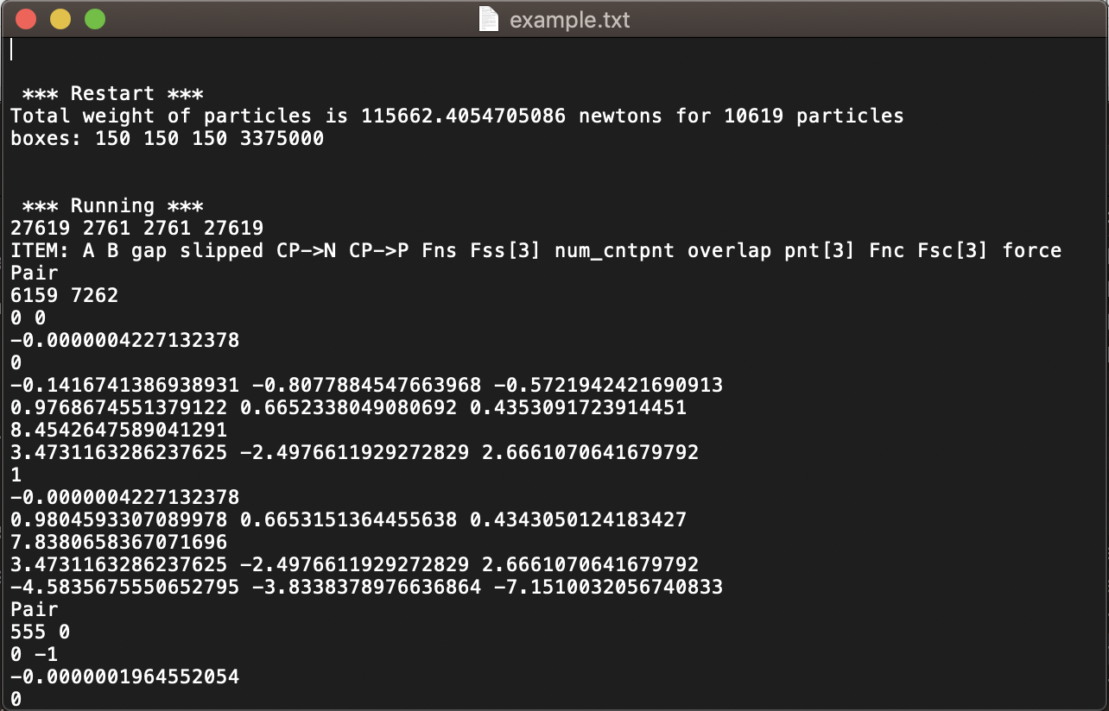
CLUSTERING
One case
~ 7 GB
.v3d file (geometry)
.txt file (mechanics)
~ 4 GB
Unstructured
303 time steps
303 time steps
part_num | mass | centroid (xyz) | minertial (xyz) | velocity (xyz) | rotation (xyz) | F_s (xyz) | F_n (xyz)
303 separate tables

Slide 8
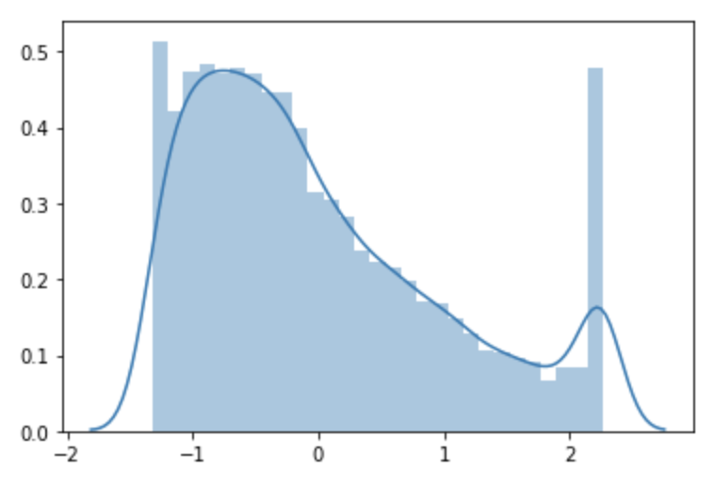
CLUSTERING
part_num | mass | centroid (xyz) | minertial (xyz) | velocity (xyz) | rotation (xyz) | F_s (xyz) | F_n (xyz)
Preprocess & Feature Engineering
How to fully utilize all the 303 files?
Take absolute value and summation for all mechanical data
Generate particle movement (x, y, z, and overall)
Generate overall particle velocity, shear force, normal force
Take logarithm for mechanical values
Winsorization
Standardization
Exclude centroid
Other processing?

Slide 9
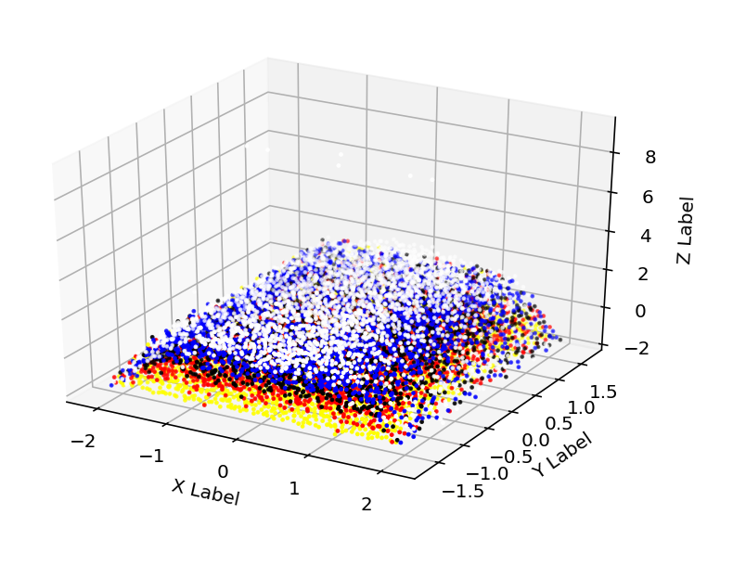
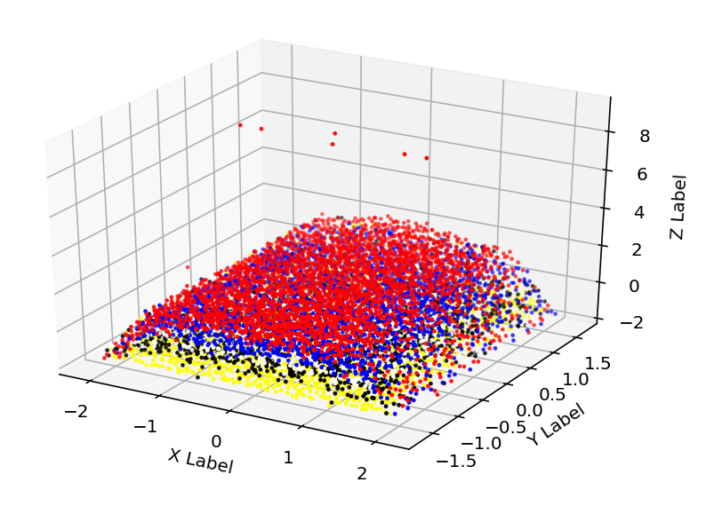
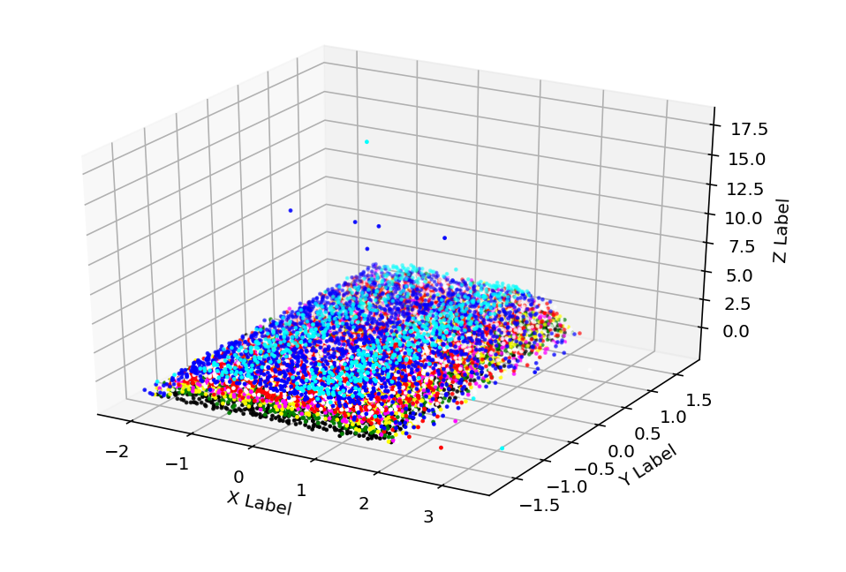
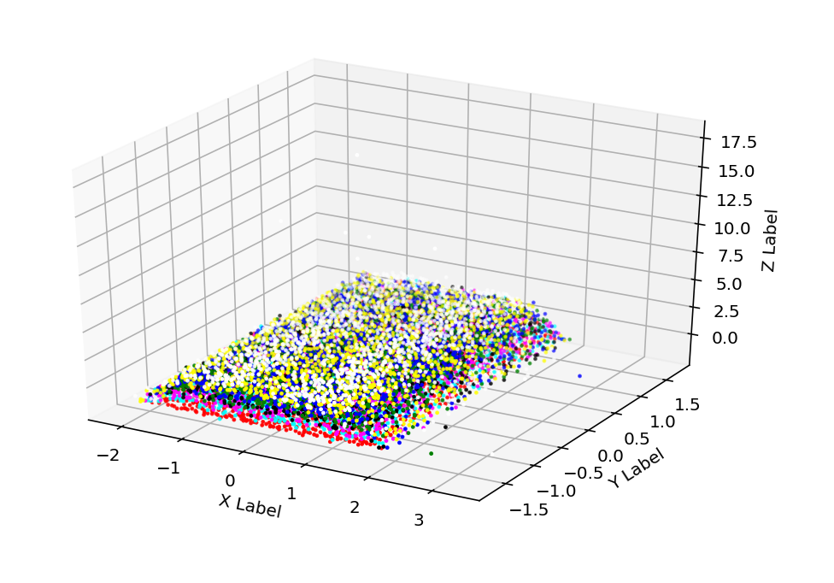
UNSUPURVISED
K-means & Hierarchical clustering
Center Binding
K-means
Hierarchical
Lack of Center Support

Slide 10
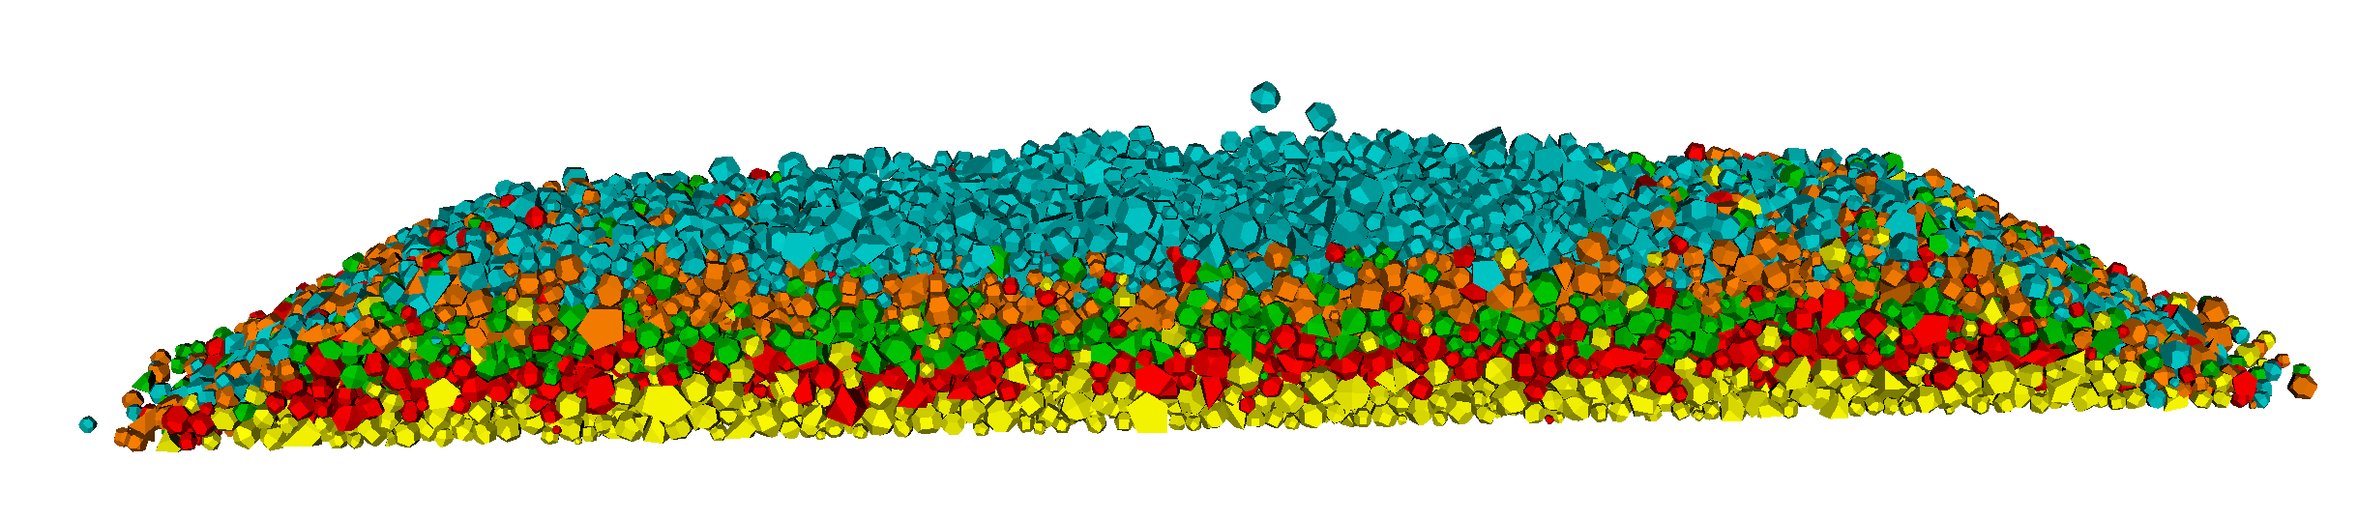
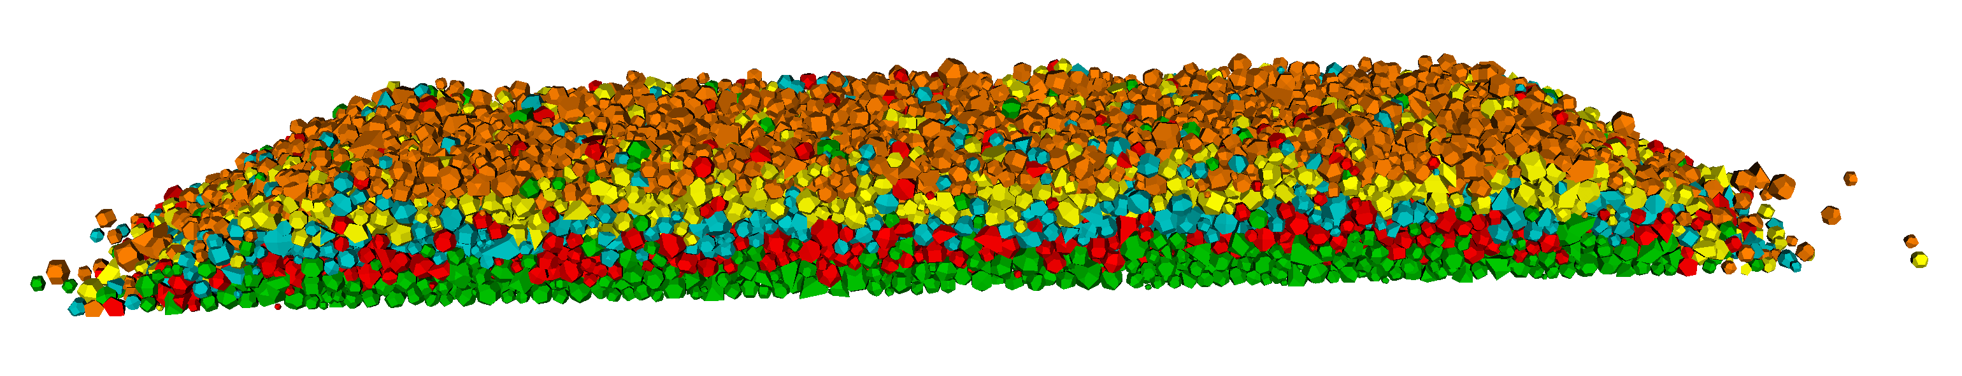
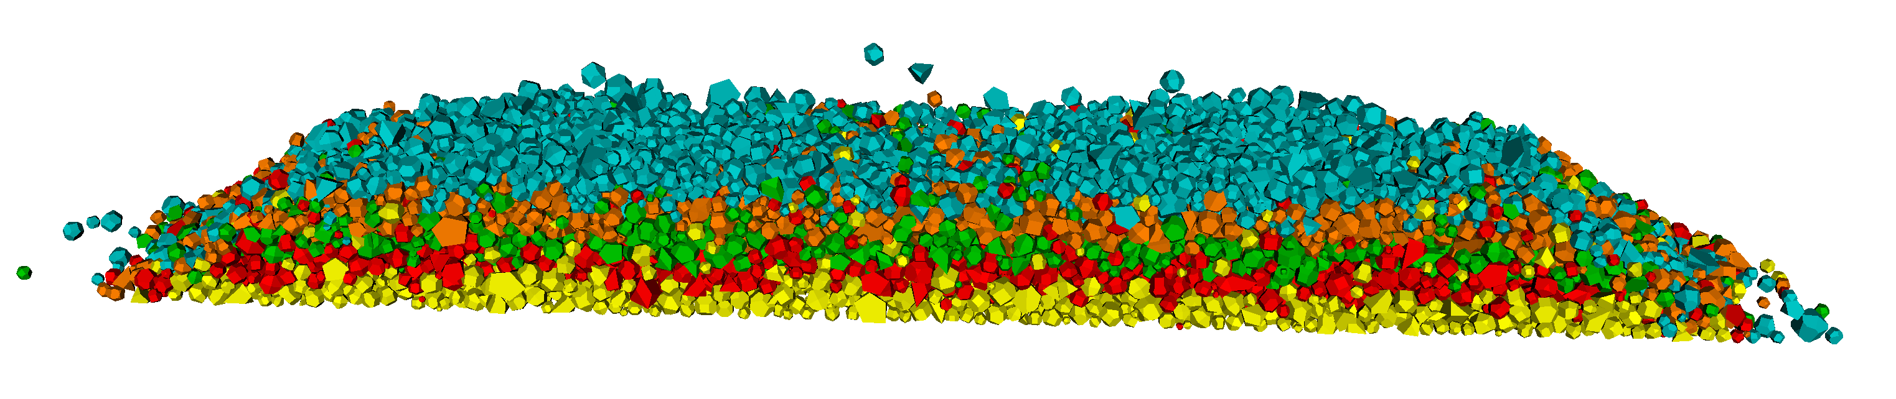
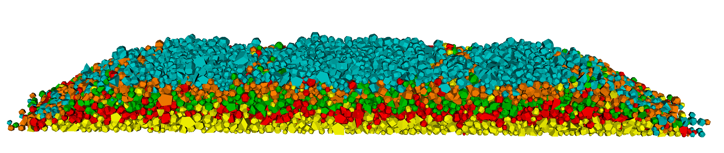
K-MEANS (Unsupervised)
High Center Binding
Full Support
vtk codes
Lack of Center Support
Lack of Rail Seat Support

Slide 11
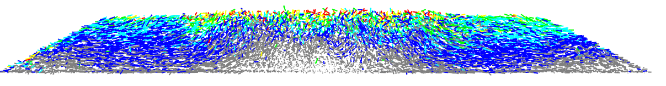
K-MEANS (Semi-supervised)
High Center Binding
Particle clustering plot
0 5 10 15 20 30
Ballast movement (mm)
Particle movement plot

Slide 12
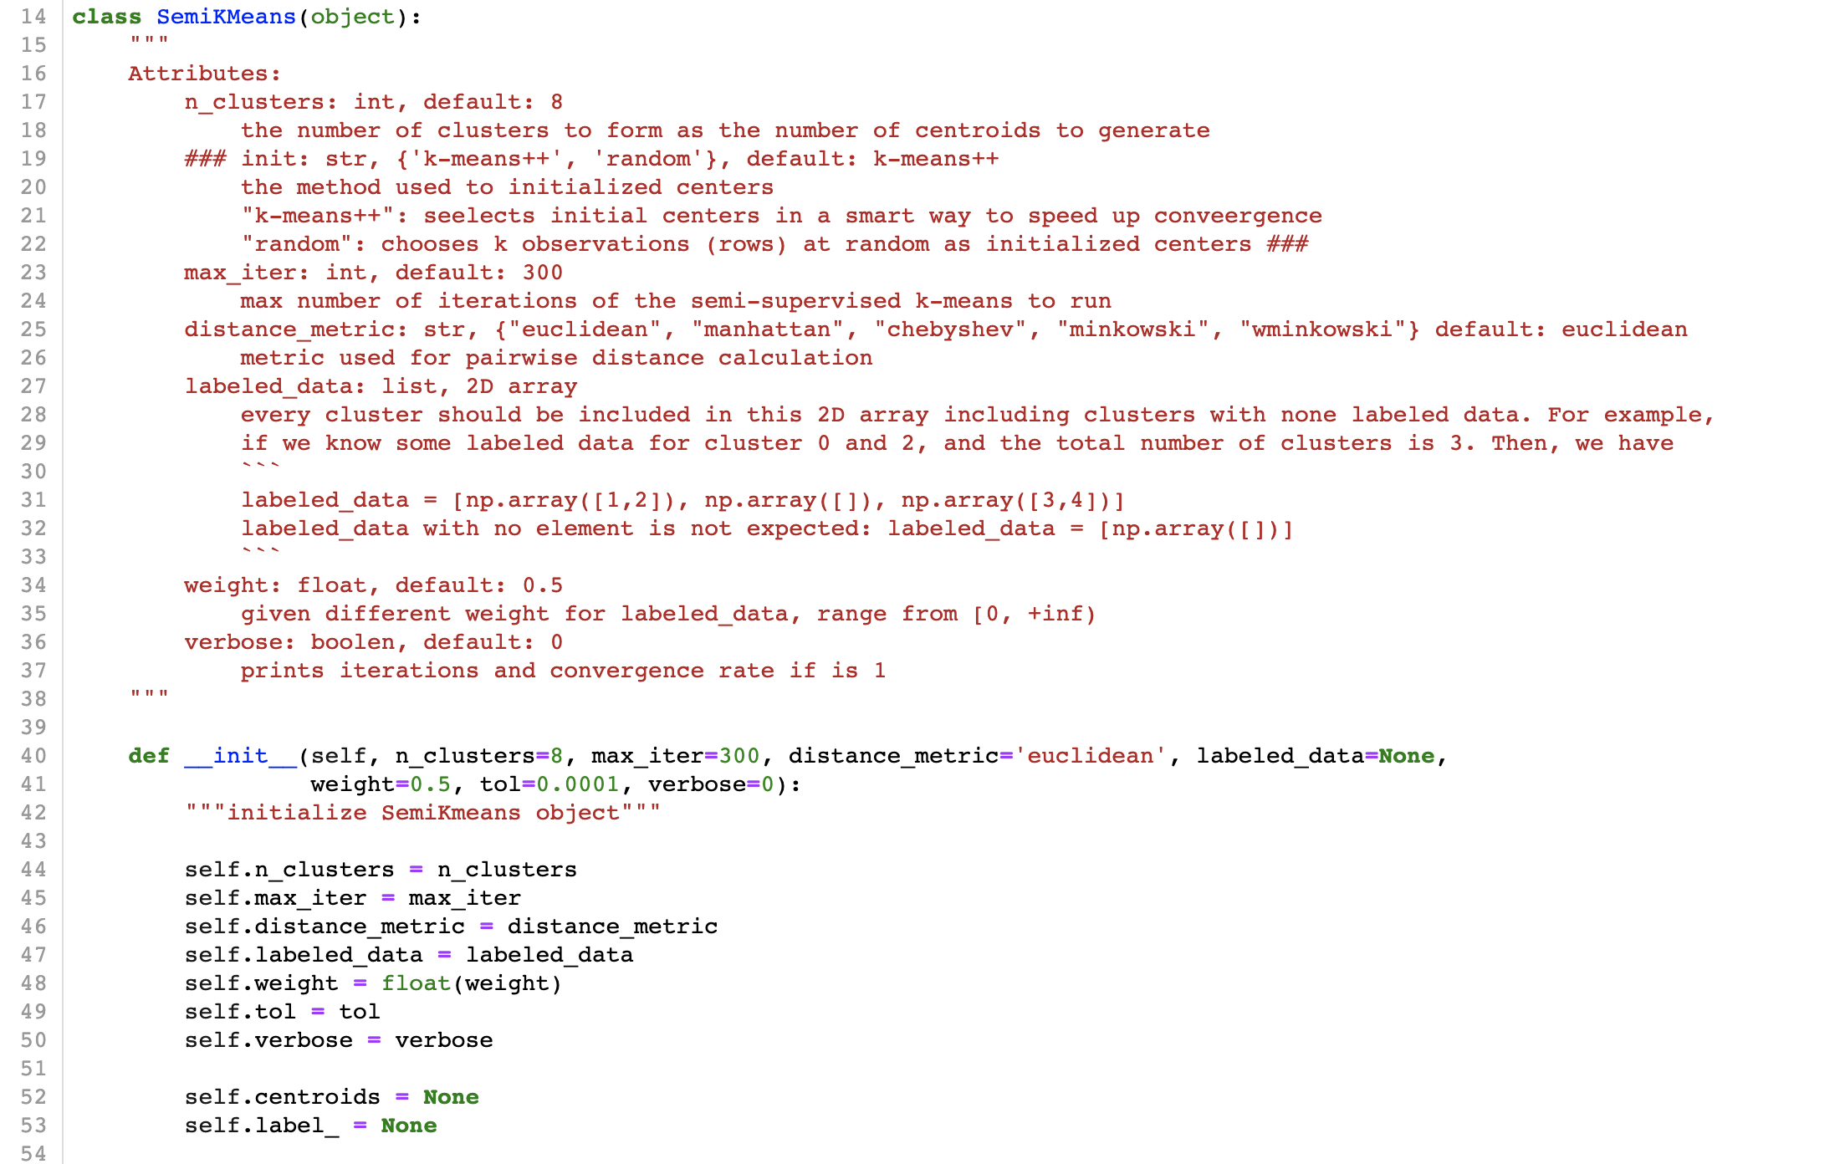
K-MEANS (Semi-supervised)

Slide 13
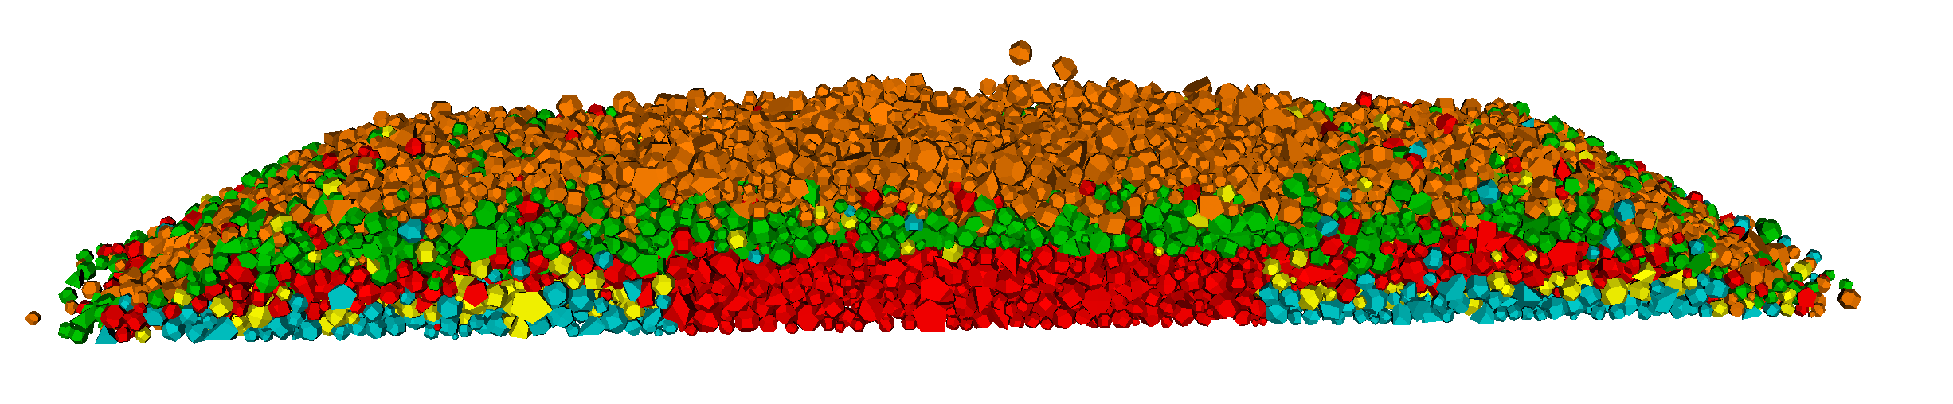
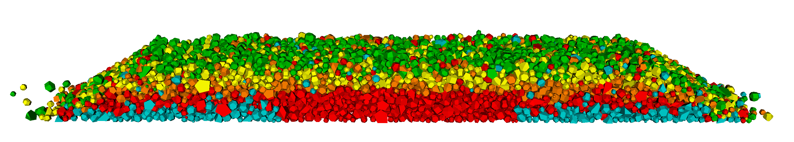
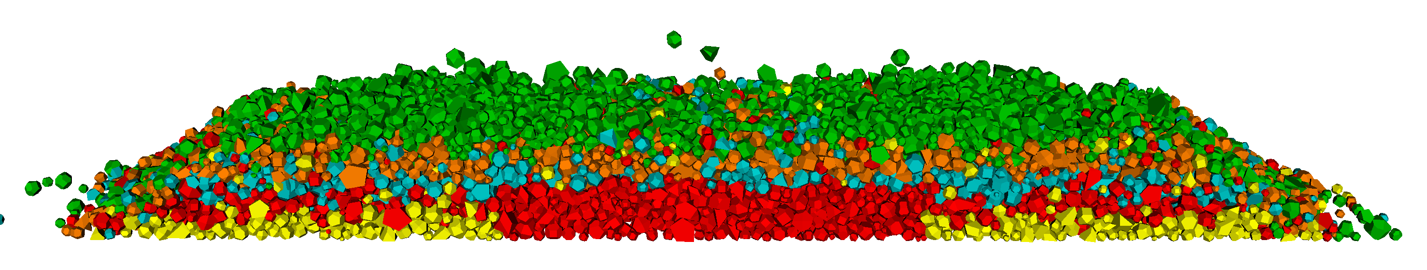
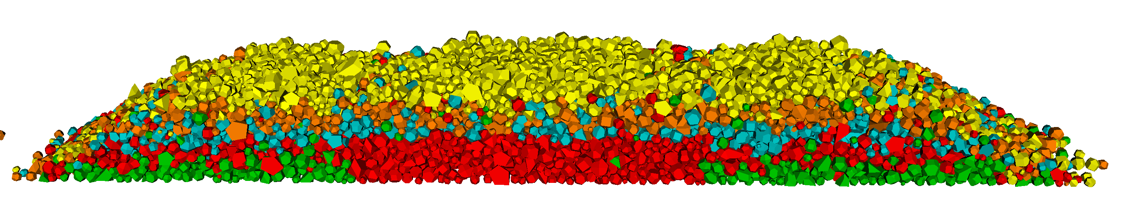
K-MEANS (Semi-supervised)
High Center Binding
Results aren’t ideal ?
Try different pre-labels
Select one potion rather than all particles within the range
… ?
Full Support
Lack of Center Support
Lack of Rail Seat Support

Slide 14
K-MEANS (Unsupervised)
High Center Binding
Full Support
vtk package
Lack of Center Support
Lack of Rail Seat Support

